Slide 1
Machine Learning (ML) RIME-832
Dr. Muhammad Jawad Khan

Slide 2
What we will discuss
1. Look at the big picture.
2. Get the data.
3. Discover and visualize the data to gain insights.
4. Prepare the data for Machine Learning algorithms.
5. Select a model and train it.
6. Fine-tune your model.
7. Present your solution. 8. Launch, monitor, and maintain your system.

Slide 3
End-to-End: The Machine Learning Pipeline

Slide 4
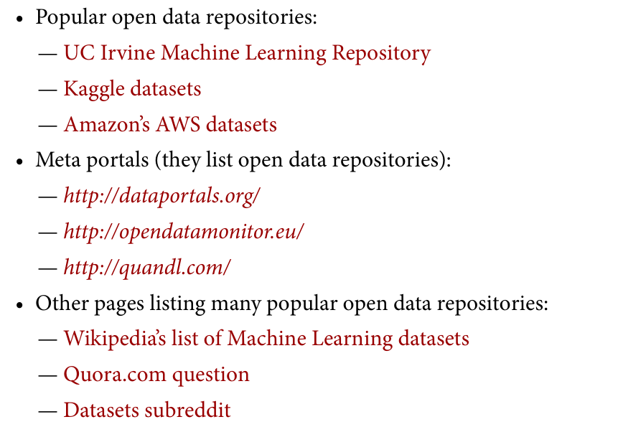

Slide 5
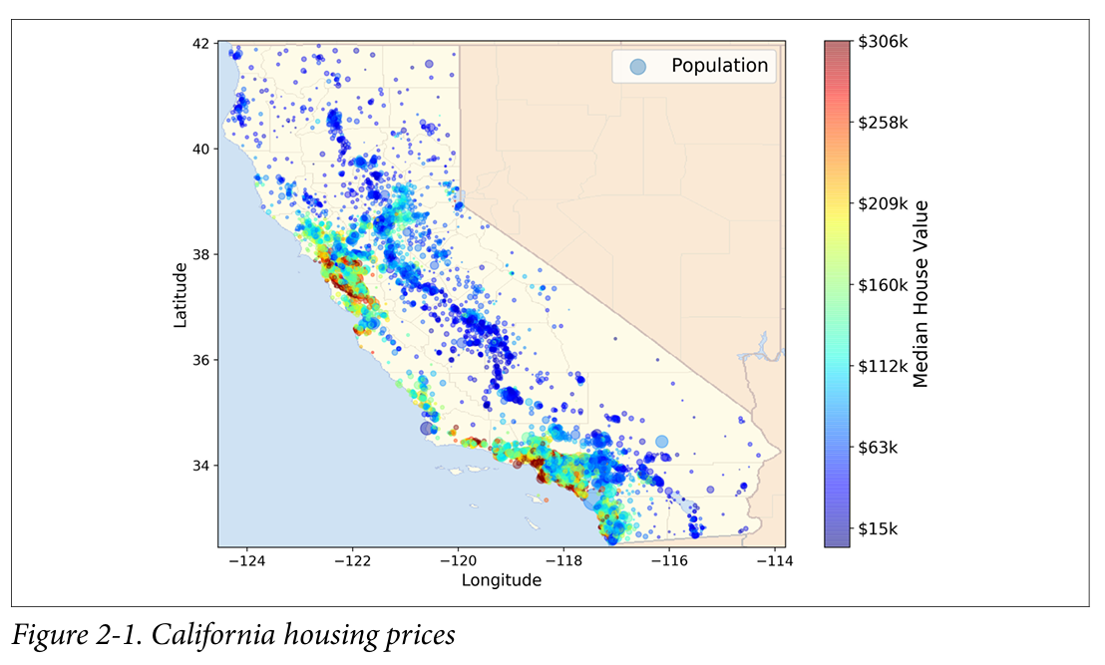
California Housing Prices dataset from the StatLib repository
This dataset was based on data from the 1990 California cen sus. It is not exactly recent (you could still afford a nice house in the Bay Area at the time), but it has many qualities for learning, so we will pretend it is recent data. We also added a categorical attribute and removed a few features for teaching purposes

Slide 6
The big picture
The first task you are asked to perform is to build a model of housing prices in California using the California census data.
This data has metrics such as the population, median income, median housing price, and so on for each block group in California.
A group typically has a population of 600 to 3,000 people
Your model should learn from this data and be able to predict the median housing price in any district, given all the other metrics.

Slide 7
The questions you must ask: First Question
The first question to ask your boss is what exactly is the business objective; building a model is probably not the end goal. How does the company expect to use and benefit from the model?
it will determine how you frame the problem, what algorithms you will select,
what performance measure you will use to evaluate your model,
How much effort you should spend tweaking it.

Slide 8
Expected Answer
Your model’s output (a prediction of a district’s median hous ing price) will be fed to another Machine Learning system along with outher parameters
This downstream system will determine whether it is worth investing in a given area or not. Getting this right is critical, as it directly affects revenue

Slide 9
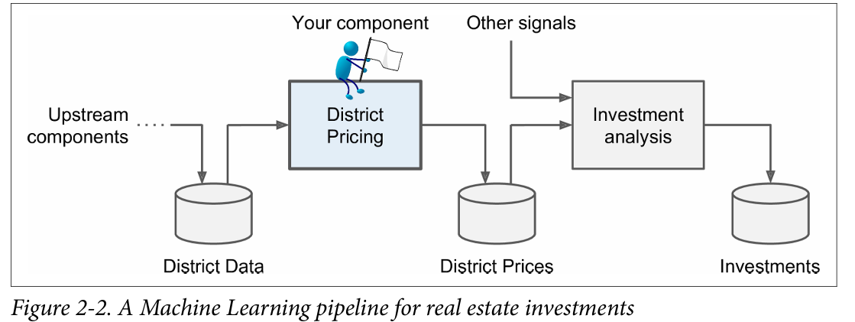

Slide 10
What is a pipeline?
A sequence of data processing components is called a data pipeline.
Each component pulls in a large amount of data, processes it, and spits out the result in another data store, and then some time later the next component in the pipeline pulls this data and spits out its own output, and so on.
If a component breaks down, the downstream components can often continue to run normally (at least for a while) by just using the last output from the broken compo nent. This makes the architecture quite robust
Broken component can go unnoticed for some time if proper monitoring is not implemented. The data gets stale and the overall system’s perfor mance drops

Slide 11
Second Question
What the current solution looks like (if any)
It will often give you a reference performance, as well as insights on how to solve the problem.

Slide 12
Expected Answer
The district housing prices are currently estimated manually by experts: a team gathers up-to-date information about a district, and when they cannot get the median housing price, they estimate it using complex rules.
This is costly and time-consuming, and their estimates are not great; in cases where they manage to find out the actual median housing price, they often realize that their estimates were off by more than 20%.

Slide 13
Frame Work
is it supervised, unsupervised, or Reinforcement learning?
Is it a classification task, a regression task, or something else?
Should you use batch learning or online learning techniques?

Slide 14
Supervised learning task since you are given labeled training examples
it is also a typical regression task, since you are asked to predict a value. More specifically, this is a multiple regression problem since the system will use multiple features to make a prediction
It is also a univariate regression problem since we are only trying to predict a single value for each district. If we were trying to predict multiple values per district, it would be a multivariate regression problem
there is no continuous flow of data coming in the system, there is no particular need to adjust to changing data rapidly, and the data is small enough to fit in memory, so plain batch learning should do just fine.

Slide 15
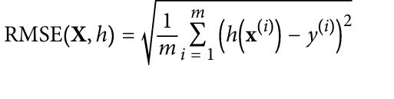
Next step: Performance measure selection
A typical performance measure for regression problems is the Root Mean Square Error (RMSE).
It gives an idea of how much error the system typically makes in its predictions, with a higher weight for large errors

Slide 16
m is the number of instances in the dataset you are measuring the RMSE.
x^{(i)} is a vector of all the feature values (excluding the label) of the i^{th} instance in the dataset, and y^{(i)} is its label (the desired output value for that instance).
X is a matrix containing all the feature values (excluding labels) of all instances in the dataset. There is one row per instance and the i^{th} row is equal to the transpose of x^{(i)}, noted (x^{(i)})

Slide 17
h is your system’s prediction function, also called a hypothesis. When your system is given an instance’s feature vector x^{(i)}, it outputs a predicted value ŷ^{(i)} = h(x^{(i)}) for that instance (ŷ is pronounced “y-hat”).
RMSE(X,h) is the cost function measured on the set of examples using your hypothesis h.
We use lowercase italic font for scalar values (such as m or y(i)) and function names (such as h), lowercase bold font for vectors (such as x(i)), and uppercase bold font for matrices (such as X).

Slide 18
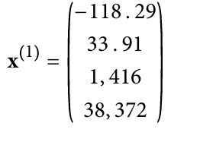

Example
if you are evaluating the RMSE on a validation set of 2,000 districts, then m = 2,000.
if the first district in the dataset is located at longitude –118.29°, latitude 33.91°, and it has 1,416 inhabitants with a median income of $38,372, and the median house value is $156,400 (ignoring the other features for now), then:

Slide 19
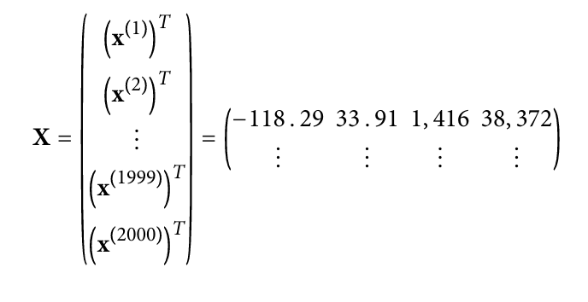
if the first district is as just described, then the matrix X looks like this:
For example, if your system predicts that the median housing price in the first district is $158,400, then ŷ(1) = h(x(1)) = 158,400. The prediction error for this district is ŷ(1) – y(1) = 2,000.

Slide 20
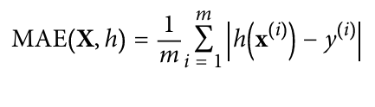
Mean Absolute Error (MAE)
If there are many outlier districts. In that case, you may consider using the Mean Absolute Error (also called the Average Absolute Deviation

Slide 21
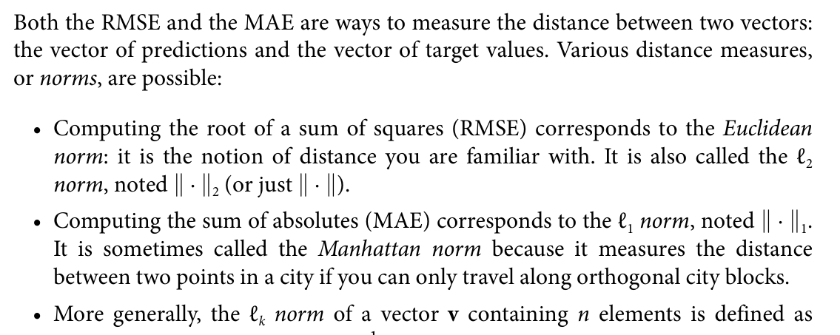

Slide 22
Next Step: Check Assumptions
it is good practice to list and verify the assumptions that were made so far (by you or others); this can catch serious issues early on.
If all is set, you are ready for implementation.

Slide 23
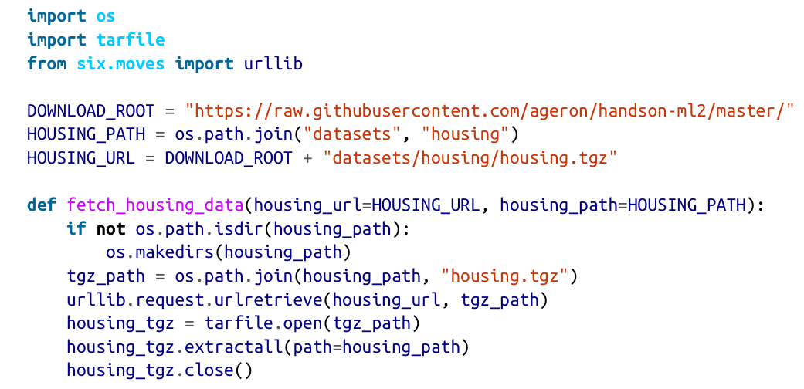
Steps for Implementation
Get Data
Create Workspace
Fetch/Download the data

Slide 24
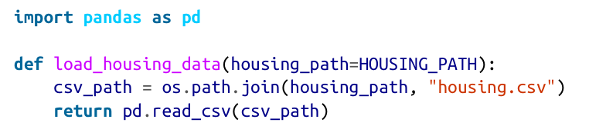
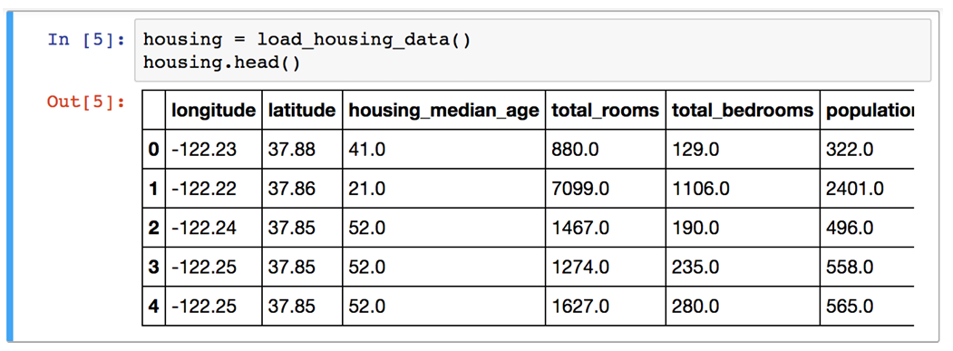
Steps for Implementation
Load the Data

Slide 25
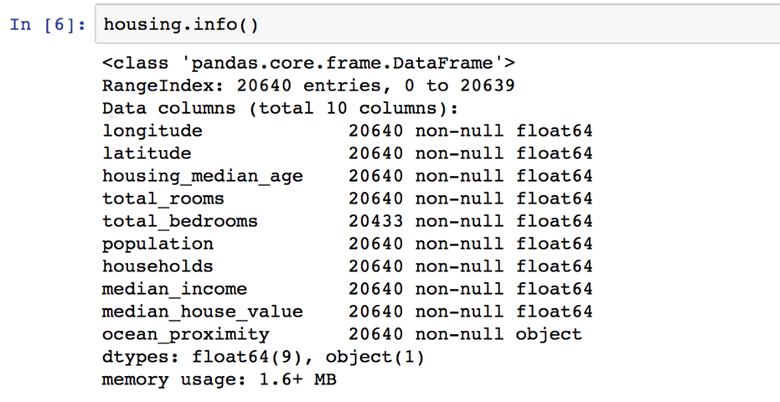

Slide 26
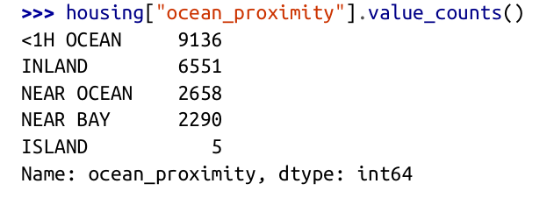
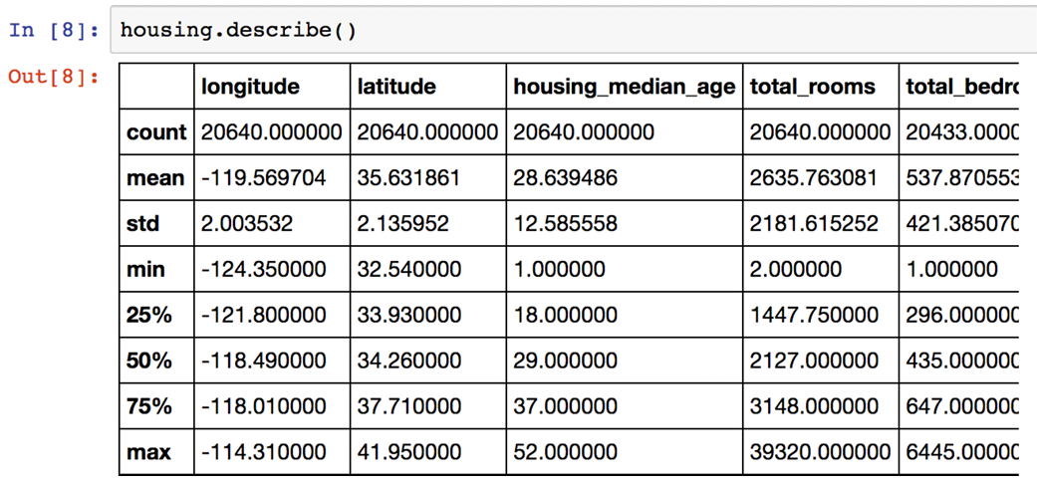

Slide 27
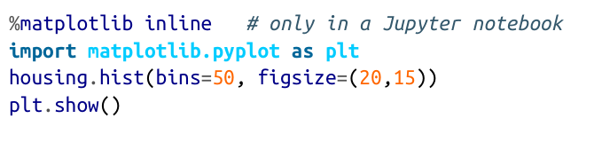
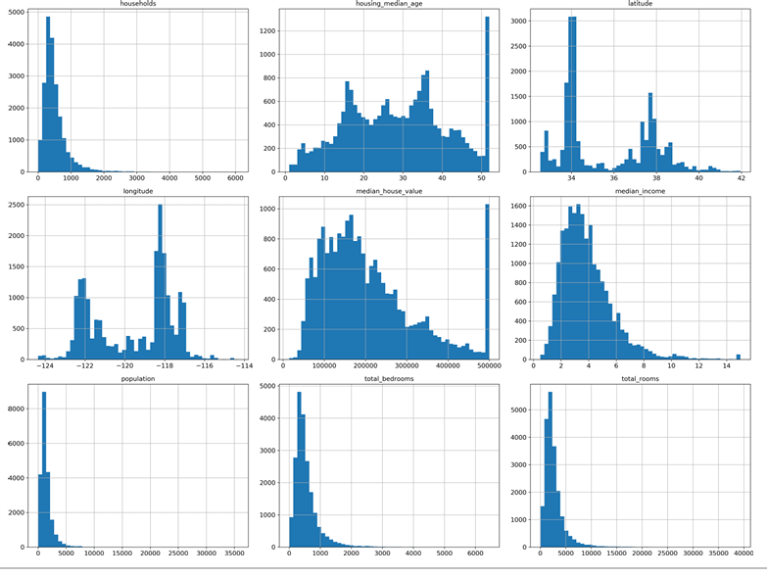

Slide 28
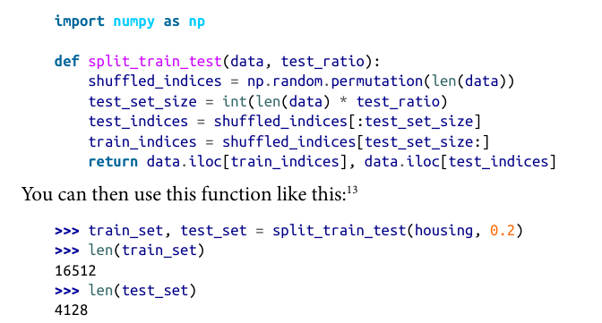
Steps for Implementation
Create a test set
this works, but it is not perfect: if you run the program again, it will generate a different test set! Over time, you (or your Machine Learning algorithms) will get to see the whole dataset, which is what you want to avoid.

Slide 29
Solution
One solution is to save the test set on the first run and then load it in subsequent runs.
Another option is to set the random number generator’s seed (e.g., np.ran dom.seed(42))14 before calling np.random.permutation(), so that it always generates the same shuffled indices. But both these solutions will break next time you fetch an updated dataset.
A common solution is to use each instance’s identifier to decide whether or not it should go in the test set

Slide 30
Scikit learn
Scikit-Learn provides a few functions to split datasets into multiple subsets in various ways.
The simplest function is train_test_split, which does pretty much the same thing as the function split_train_test defined earlier, with a couple of additional features.
First there is a random_state parameter that allows you to set the random generator seed as explained previously
Second you can pass it multiple datasets with an identical number of rows, and it will split them on the same indices (this is very useful, for example

Slide 31
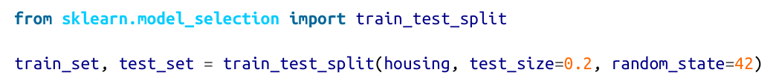

Slide 32
Suppose you chatted with experts who told you that the median income is a very important attribute to predict median housing prices. You may want to ensure that the test set is representative of the various categories of incomes in the whole dataset. Since the median income is a continuous numerical attribute, you first need to create an income category attribute.

Slide 33
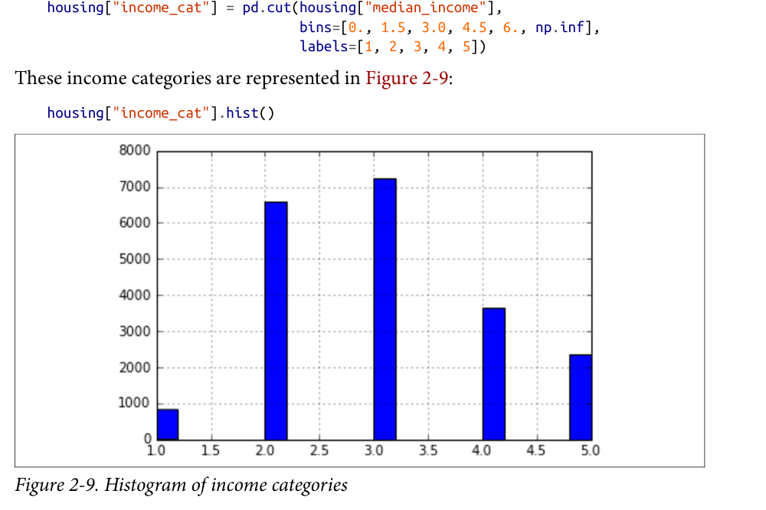

Slide 34
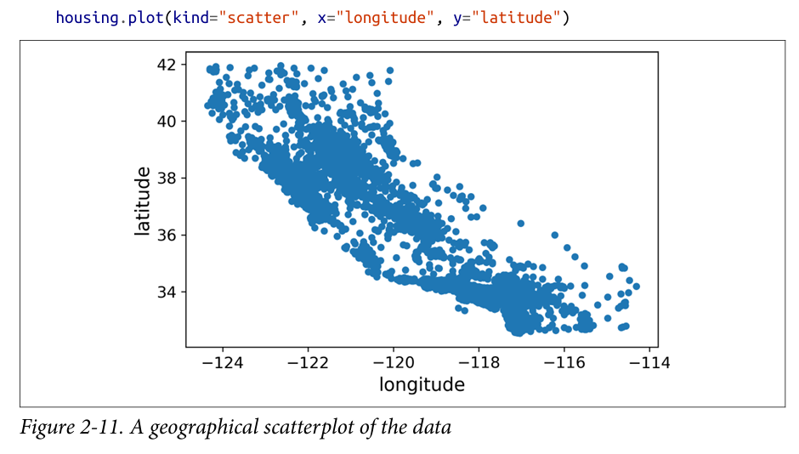
Discover and Visualize
create a scatterplot of all districts to visualize the data

Slide 35
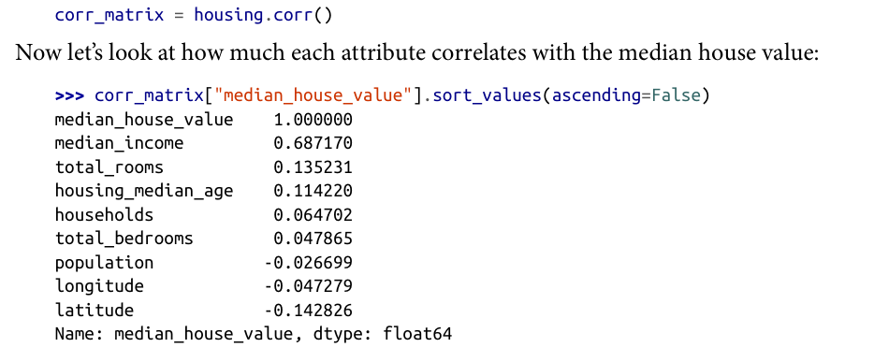
Find Correlations
Since the dataset is not too large, you can easily compute the standard correlation coefficient (also called Pearson’s r) between every pair of attributes using the corr() method

Slide 36

Prepare Data for ML
Make a backup of data

Slide 37
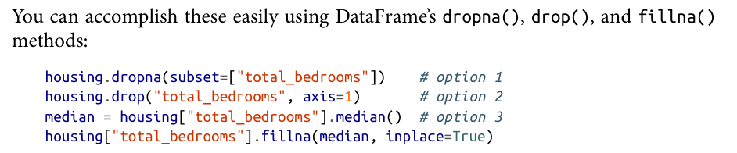
Data Cleaning
Features with missing attributes:
Get rid of the corresponding values
Get rid of the whole attribute
Set the values to some value (zero, the mean, the median, etc.).

Slide 38
Feature Scaling
There are two common ways to get all attributes to have the same scale: min-max scaling and standardization Already discussed in lecture 2

Slide 39
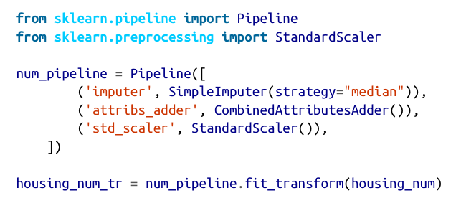
Transformation Pipeline
Scikit-Learn provides the Pipeline class to help with sequences of transformations.

Slide 40
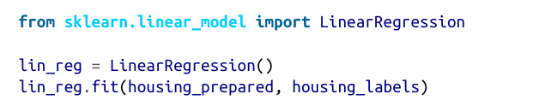
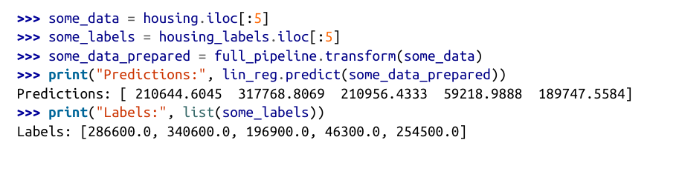
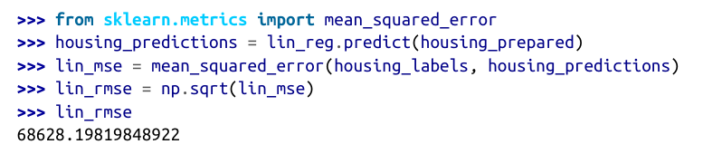
Select and train model

Slide 41
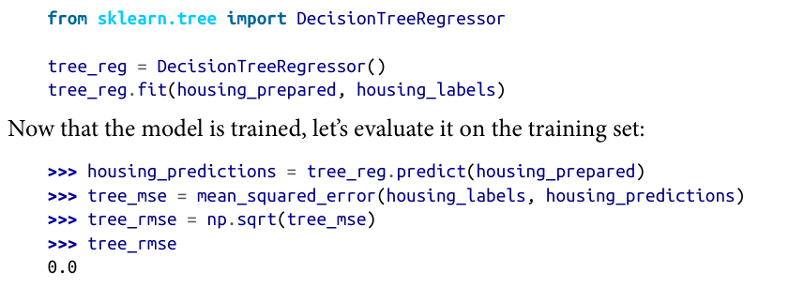
Another model
How decision tree works?

Slide 42
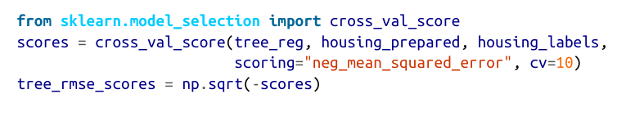
Use Cross Validation

Slide 43
Cross Validation
We can solve our dilemma by repeating the training many times on different partitioning
This is known as K-fold cross validation

Slide 44
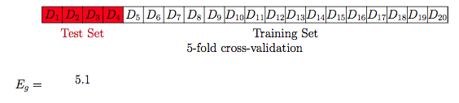
Cross Validation

Slide 45
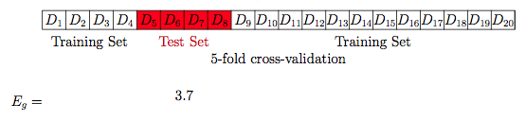
Cross Validation

Slide 46
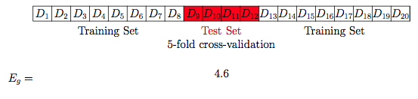
Cross Validation

Slide 47
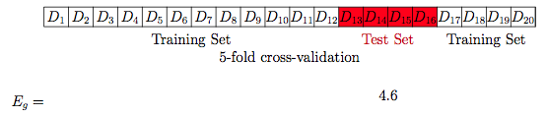
Cross Validation

Slide 48
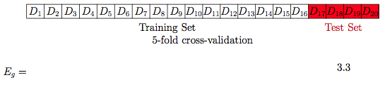
Cross Validation

Slide 49
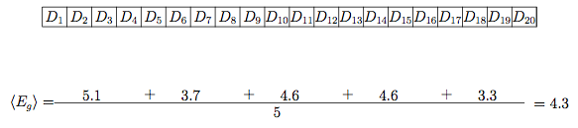
Cross Validation

Slide 50
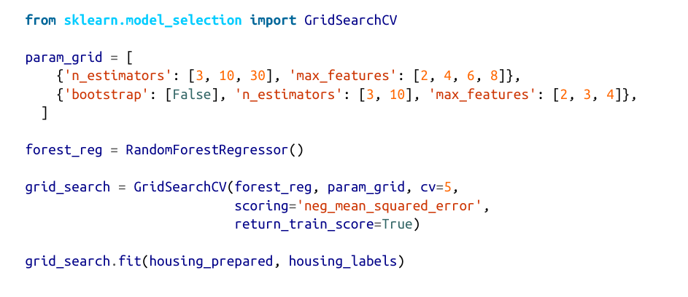
Fine Tune Model

Slide 51
Ensemble Models
Analyze the Best Models and Their Errors

Slide 52
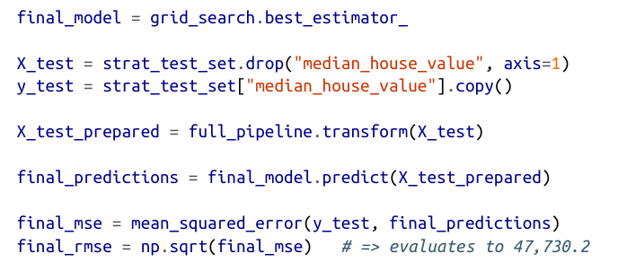
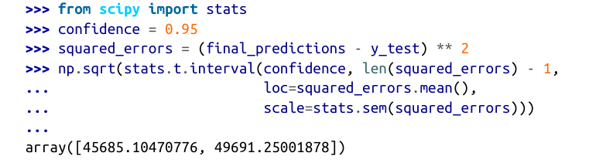
Evaluate on test data

Slide 53
Once done
You are ready to launch your model

